Slide 1
Ashesi University department of business administration BUSA 224: Finance for non-finance managers
Course Faculty:
A. Alu

Slide 2
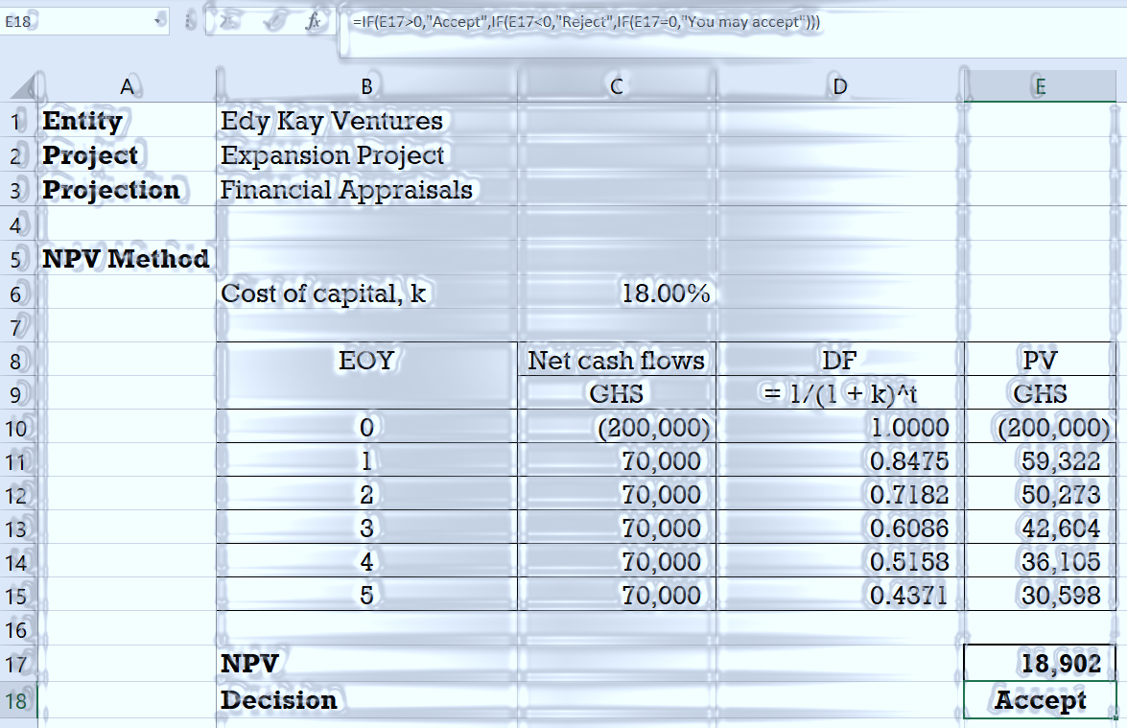
Capital Budgeting Techniques
Investment Appraisals
NPV
IRR
PI
Payback period
Sensitivity analysis
Chapter 13 of Fundamentals of Financial Management by Van Horne and Wachowicz

Slide 3
Opening Statement
Investment projects should be evaluated based on value-maximizing criteria.
Notes:
The evaluation is done to answer the question “Will the implementation of this project increase the value of shareholders?”
Sometimes, the value of the project is not measurable in financial terms.
The evaluation should include an analysis of the impact on other stakeholders

Slide 4
Financial appraisal of investments
Financial appraisal involves the following:
Estimating incremental after- tax cash flows that will flow from the investment.
Appraising the incremental after-tax cash flows to establish whether they would add value to the firm at a lower risk.
The objective of financial appraisal is to establish whether the implementation of the proposed investment will be worthwhile or not.

Slide 5



Contents
Capital budgeting techniques under certainty.
Capital budgeting techniques under uncertainty.
Dealing with potential difficulties.
Notes:
Objectives:
Understand the three major discounted cash flow techniques: NPV, IRR, and PI
Understand the payback period method.
Explain the advantages of each of the major DCF techniques over the payback period method.
Understand why ranking projects based on NPV, IRR and PI may lead to conflict in the ranking.
Understand the usefulness of sensitivity analysis in challenging the single-point estimates of the traditional techniques.
Explain the role and process of project monitoring.

Slide 6
Learning Outcomes
Apply
Apply
Explain
Apply the three major discounted cash flow (DCF) methods of project evaluation and selection – the NPV, IRR, and PI.
Apply the payback period (PBP) method of project evaluation and selection.
Explain why ranking project proposals based on the IRR, NPV, and PI methods “may” lead to conflicts in rankings.

Slide 7
Learning Outcomes
Describe
Perform
Explain
Describe the situations where ranking projects may be necessary.
Perform “sensitivity analysis” for a project.
Explain the role and process of project monitoring, including “progress reviews” and “post-completion audits.”

Slide 8
capital budgeting Techniques under certainty
The NPV approach
The profitability index (PI) approach
The internal rate of return (IRR) approach

Slide 9
Investment appraisal under certainty
Under the assumption of certainty, we are 100% sure that the actual cash flows from the project will not be different from the projected cash flows.
Planning conditions will not be different from implementation conditions.
No simulations to answer the question: What if something changes”.
So we do a single point appraisal.
Single point appraisals are done when project CFs can be estimated with certainty.
Simulations are done when cash flows cannot be estimated with certainty.

Slide 10
Discounted Cash flow Techniques (DCF) techniques
The NPV approach
The profitability index (PI) approach
The internal rate of return (IRR) approach
Discounted cash flow (DCF) techniques are methods of investment project evaluation and selection that adjusts cash flows over time for the time value of money.

Slide 11
Concept Review: Present Value
The PV a Single Amount
The PV of an Annuity
$${PV}_{0}=\frac{{NCF}_{t}}{{\left(1+k\right)}^{t}}$$
PV_0=NCF_t/(1+k)^t
$${PV}_{0}={NCF}_{t}×\frac{1}{{\left(1+k\right)}^{t}}={NCF}_{t}×DF$$
PV_0=NCF_t×1/(1+k)^t =NCF_t×DF
$${PV}_{0}=NCF×\left(\frac{1−\frac{1}{{\left(1+k\right)}^{t}}}{k}\right)$$
PV_0=NCF×((1−1/(1+k)^t )/k)
$${PV}_{0}=NCF×DFA$$
PV_0=NCF×DFA
Discounted cash flow (DCF) techniques are based on the concept of present value.

Slide 12
Next
The NPV technique

Slide 13
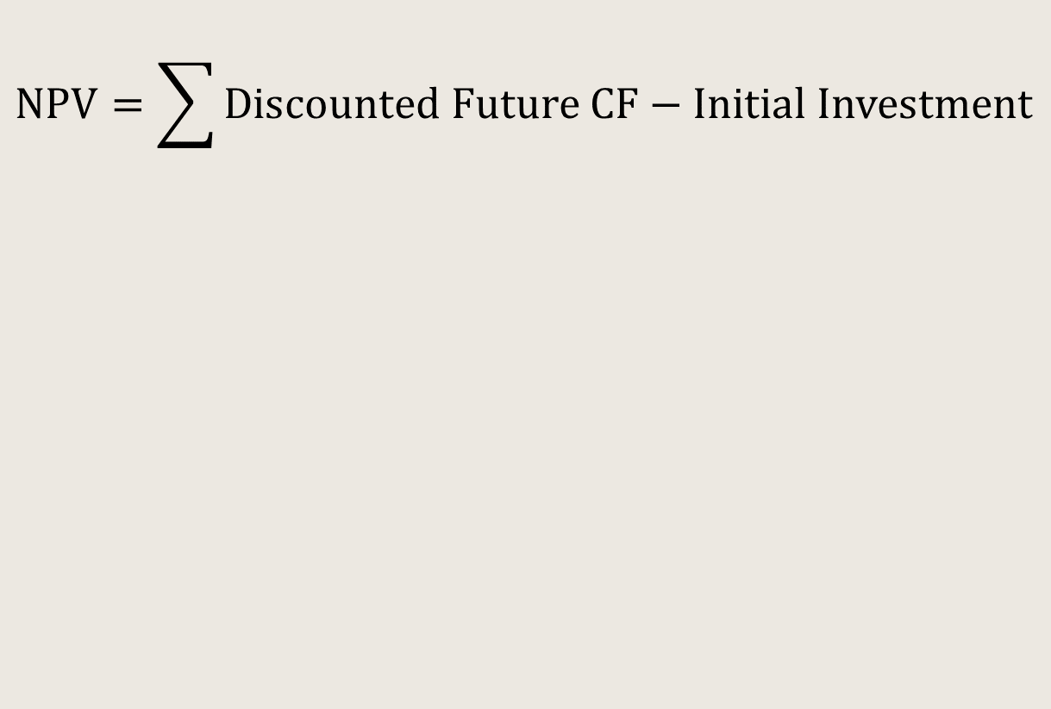
The NPV technique
$$NPV=\sum{Discounted Future CF−Initial Investment}$$
The net present value is the aggregate present value of all the cash flows associated with the project.
The NPV is computed as project’s net cash flows minus the project’s initial cash outflow.
Decision Rule
Projects with positive NPV should be implemented.
A positive NPV suggests that the project will add value to the firm

Slide 14
NPV and shareholder wealth maximisation
Implementation of Projects with Positive NPV
Increase in shareholders’ wealth

Slide 15
Illustration 10.1: Computation of NPV
Assumptions:
Management of Edy Kay Ventures is considering an expansion project which entails an immediate investment of GHS200,000 and will produce GHS70,000 in each of the next five years.
The cost of financing the project is 18%.
Problem
Appraise the project using the three DCF techniques and indicate whether the project should be implemented.

Slide 16
Illustration 10.1: Based on NPV /1
Discount future cash flows:
$${PV}_{0}=NCF×\left(\frac{1−\frac{1}{{\left(1+k\right)}^{t}}}{k}\right)$$
PV_0=NCF×((1−1/(1+k)^t )/k)
$${PV}_{0}=70,000×\left(\frac{1−\frac{1}{{\left(1+0.18\right)}^{5}}}{0.18}\right)$$
PV_0=70,000×((1−1/(1+0.18)^5 )/0.18)
$${PV}_{0}=70,000×3.1272=218,904$$
PV_0=70,000×3.1272=218,904
Compute NPV
$$NPV=218,904−200,000=18,904$$
NPV=218,904−200,000=18,904
As the future CF is the same amount every, it is discounted as an annuity.
The NPV of the project is GHS18,904.
The positive NPV implies that the implementation of this project will increase shareholders’ wealth.

Slide 17
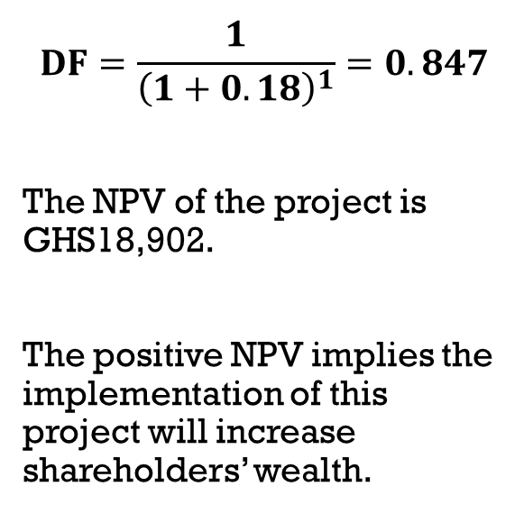
Illustration 10.1: Based on NPV /2
$$DF=\frac{1}{{\left(1+0.18\right)}^{1}}=0.847$$
The NPV of the project is GHS18,902.
The positive NPV implies the implementation of this project will increase shareholders’ wealth.

Slide 18
Next
The profitability index technique

Slide 19
Profitability Index (PI)
Computation:
$$PI = \frac{Sum of PV of Future NCF}{Initial Investment}$$
PI = (Sum of PV of Future NCF)/(Initial Investment)
Decision rule
Accept the project if its PI > 1
Reject the project if its PI < 1.
Also known as benefit-cost ratio.
It is the PV of an investment’s future cash flows divided by the initial cash outflow.

Slide 20
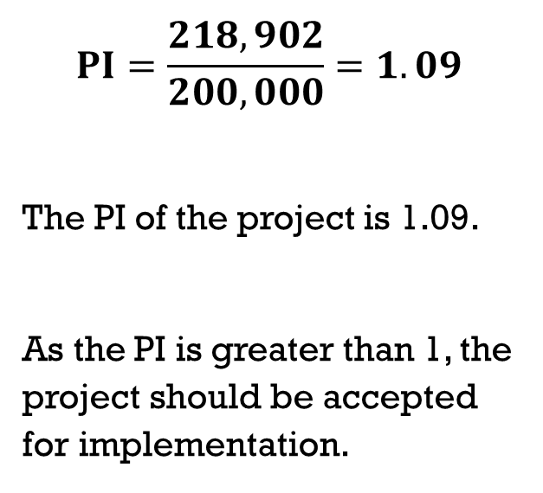
Illustration 10.1: Based on PI
$$PI=\frac{218,902}{200,000}=1.09$$
The PI of the project is 1.09.
As the PI is greater than 1, the project should be accepted for implementation.

Slide 21
Relationship between NPV and PI
If a project’s NPV is positive then the PV of future cash flows from the project is more than the initial cash outflow; and so, its PI will be greater than 1.
If a project’s NPV is negative then the PV of future cash flows from the project is less than the initial cash outflow; and so, its PI will be less than 1.
A project with positive NPV has PI > 1 and a project with negative NPV has PI < 1.

Slide 22
Strength and weakness of PI
Strength
Its result is identical to that of the NPV method.
Weakness
May lead to incorrect decisions when comparing mutually exclusive projects.

Slide 23
Next
The IRR technique

Slide 24
The internal rate of return (IRR) technique
Formula
$${IRR=i}_{L}+\left(\frac{{NPV}_{L}}{{NPV}_{L}−{NPV}_{H}}\right)(i_{H}−i_{L})$$
〖IRR=i〗_L+(NPV_L/(NPV_L−NPV_H ))(i_H−i_L)
Decision rule
Acceptance: IRR > hurdle rate
Rejection: IRR < hurdle rate
The IRR is the discount rate that equates the aggregate PV of future cash flows to the initial investment.
That is, the discount rate that yields a zero NPV.
Notes:
PT Corp wants to invest in a new machine that costs GHS90,000. The running of the machine will result in after-tax net operating cash flows of GHS –15,000, GHS – 5,000, GHS85,000, and GHS140,000 at the end of years one, two, three, and four respectively. The final salvage value of the machine at the end of four years is GHS10,000. Cost of capital is 12% whereas reinvestment rate is 13%.
Required:
Computes the projects IRR, would you advise that the project is implemented?
What is the modified internal rate of return (MIRR) of the project? Based on MIRR, would you advise management of the firm to invest in the machine?

Slide 25
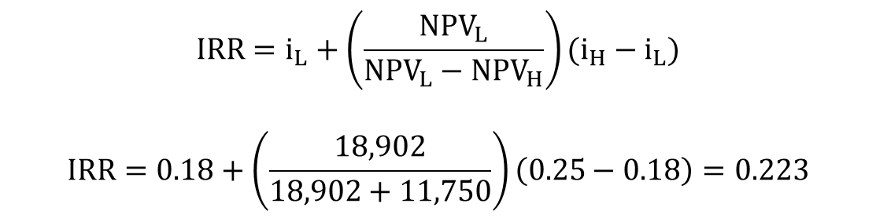
Illustration 10.1: Based on IRR
The IRR of the project is 22.3%.
Set the hurdle rate to the cost of capital.
As the IRR (22.3%) is greater than the cost of capital (18%), the project should be accepted for implementation.
$${IRR=i}_{L}+\left(\frac{{NPV}_{L}}{{NPV}_{L}−{NPV}_{H}}\right)(i_{H}−i_{L})$$
$$IRR=0.18+\left(\frac{18,902}{18,902+11,750}\right)\left(0.25−0.18\right)=0.223$$

Slide 26
Strengths and weaknesses of IRR
Strengths
It is a relative measure (expressed in %), and so can easily be compared to that of other investments.
Managers understand it much better as it is expressed in the same form as the finance rate.
Weaknesses
There may be multiple IRRs from nonconventional cash flows.
Inefficient in appraising mutually exclusive projects.
The IRR method is perhaps the most criticised DCF technique.

Slide 27
Next
The NPV profile

Slide 28
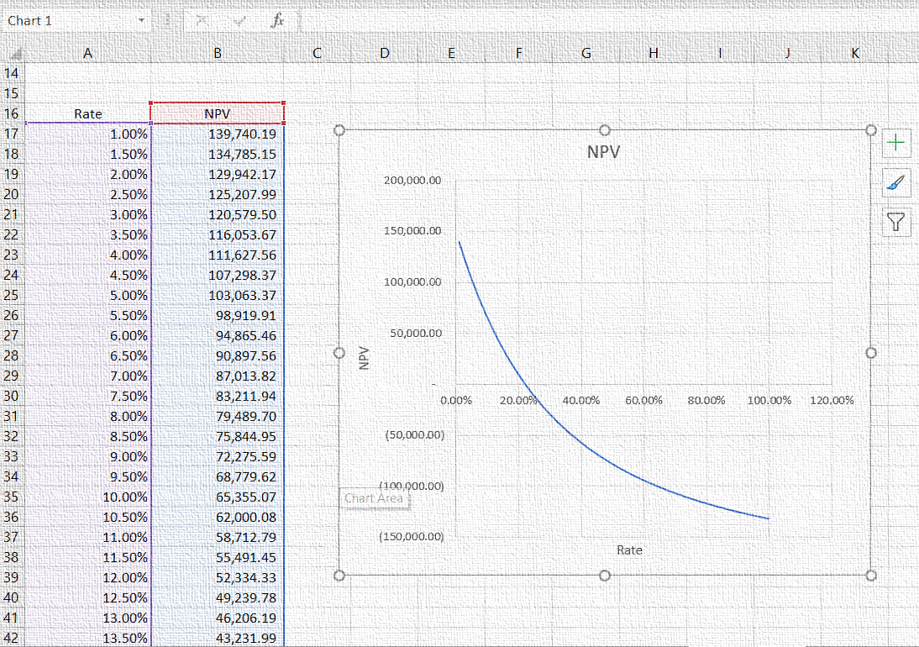
The NPV profile
Given the project’s NCFs, we can compute the NPV of a project using varying discount rates.
Plotting the varying discount rates and their corresponding NPVs yields the graph named as the “NPV profile”.
Notes:
NPV profile is a graph showing the relationship between a project’s net present value and the discount rate employed.

Slide 29
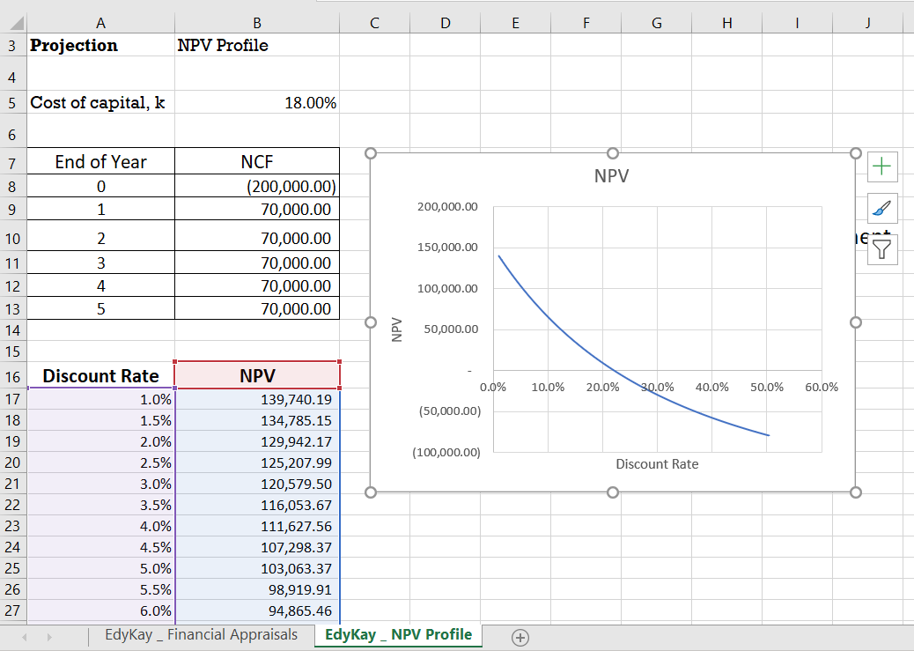
Illustration 10.2: Graphing an NPV profile
In this Illustration, I demonstrate how to graph an NPV profile.
Refer to the assumptions under Illustration 10.1 relating to the expansion project of Edy Kay Ventures.
← See the accompanying recording and workbook.

Slide 30
Next
Appraisal results for DML Plc’s Expansion Project
Notes:
Let us apply the DCF techniques we have learnt

Slide 31
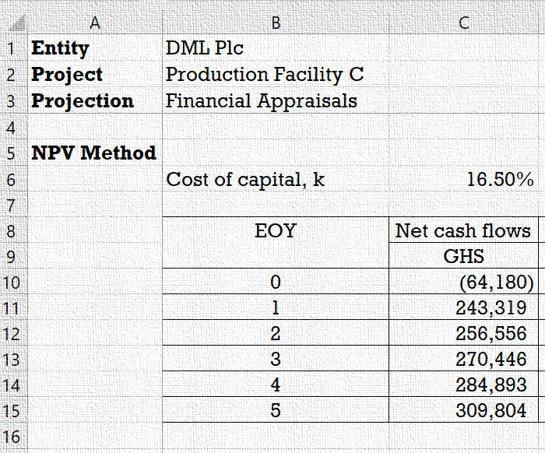
Illustration 10.3: Appraisal of the DML Expansion Project
Let is consider the expansion project of DML Plc we discussed in Lecture 6.
We have estimated the annual NCFs associated with the project.
Now let us look at how to evaluate the cash flows to determine whether the project will add value to the firm.

Slide 32
Illustration 10.3: Based on NPV /1
Discount future cash flows:
$${PV}_{0}=\sum_{t=1}^{n}{\frac{{NCF}_{t}}{{\left(1+k\right)}^{t}}}$$
PV_0=∑24_(𝑡=1)^𝑛▒NCF_t/(1+k)^t
$${PV}_{0}=867,953$$
PV_0=867,953
Compute NPV
$$NPV=867,953−64,180=803,773$$
NPV=867,953−64,180=803,773
${PV}_{0}=\frac{243,319}{{\left(1+.165\right)}^{1}}+\frac{256,556}{{\left(1+.165\right)}^{2}}+\frac{270,446}{{\left(1+.165\right)}^{3}}+\frac{284,893}{{\left(1+.165\right)}^{4}}+\frac{309,804}{{\left(1+.165\right)}^{5}}$
PV_0=243,319/(1+.165)^1 +256,556/(1+.165)^2 +270,446/(1+.165)^3 +284,893/(1+.165)^4 +309,804/(1+.165)^5
As the future CFs are different, they are discounted as single amounts.
The NPV of the project is GHS803,773.
The positive NPV implies that the implementation of this project will increase shareholders’ wealth.

Slide 33
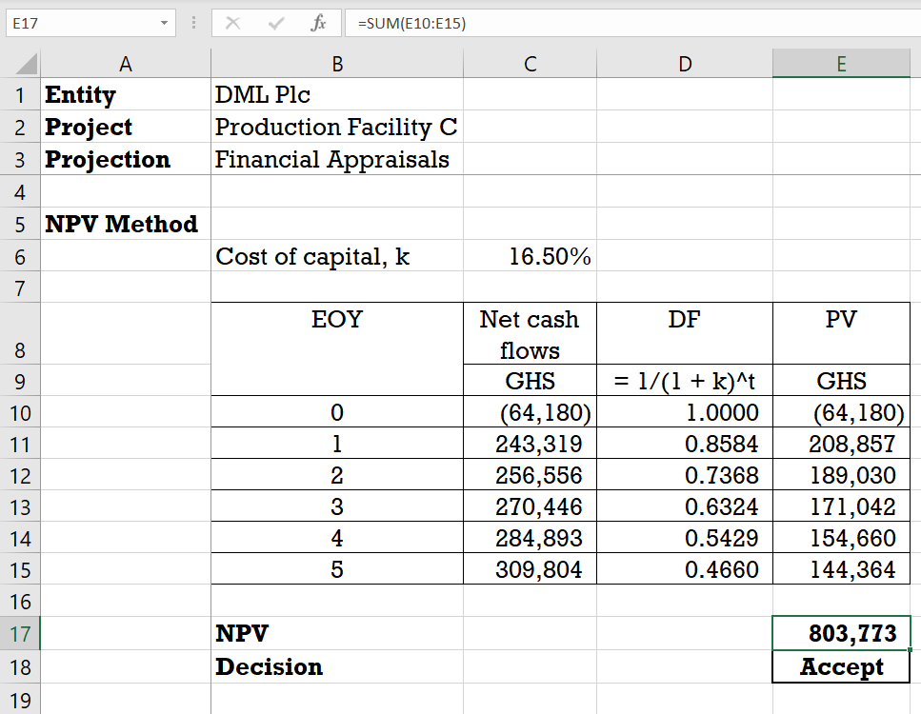
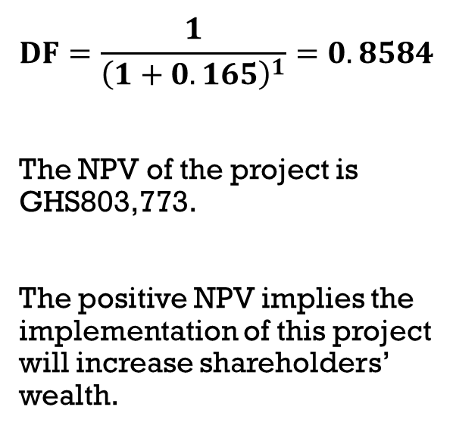
Illustration 10.3: Based on NPV /2
$$DF=\frac{1}{{\left(1+0.165\right)}^{1}}=0.8584$$
The NPV of the project is GHS803,773.
The positive NPV implies the implementation of this project will increase shareholders’ wealth.

Slide 34
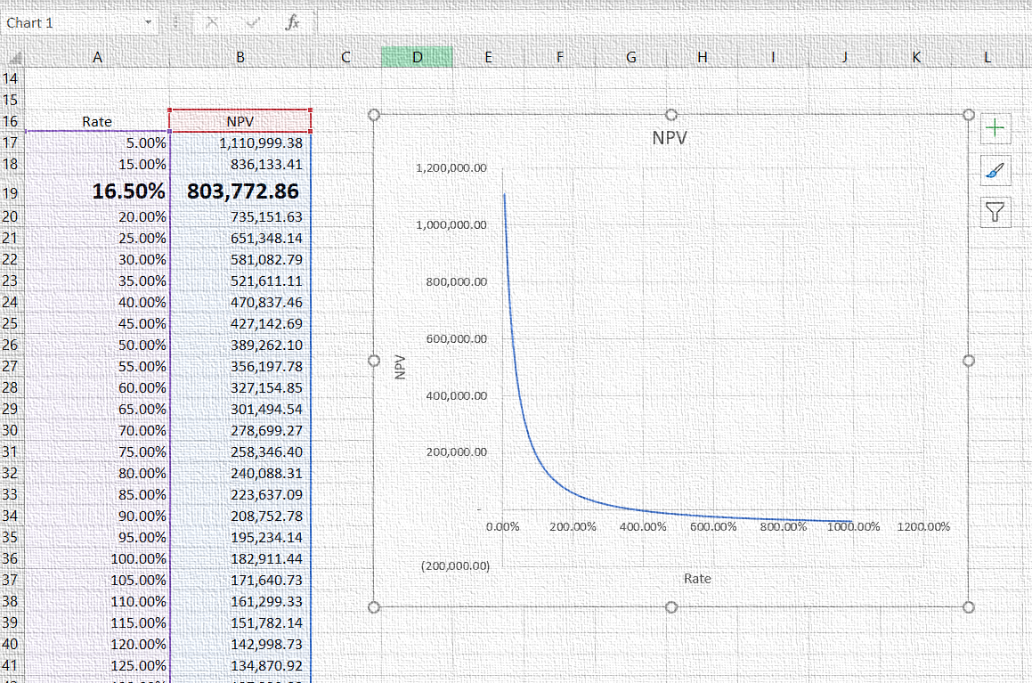
Illustration 10.3 The NPV profile
Given the project’s NCFs, we can compute the NPV of the project using varying discount rates.
Plotting the varying discount rates and their corresponding NPVs yields the graph named as the “NPV profile”.
Notes:
NPV profile is a graph showing the relationship between a project’s net present value and the discount rate employed.

Slide 35
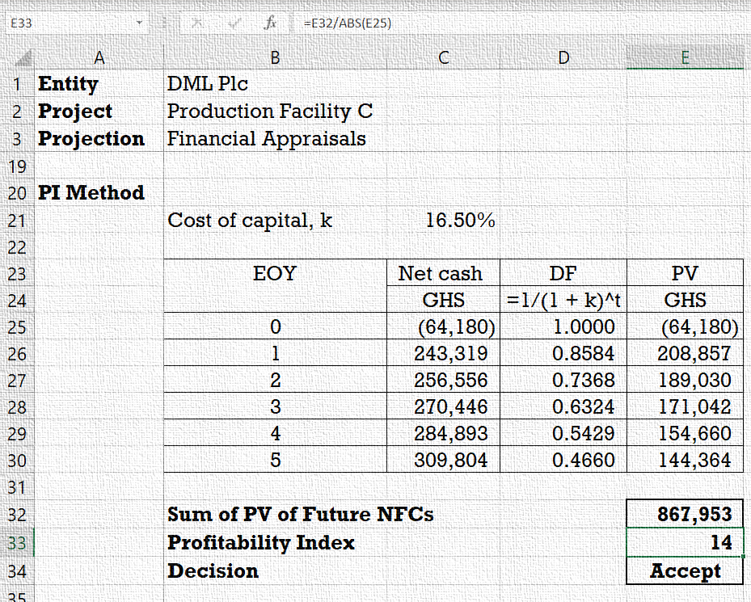
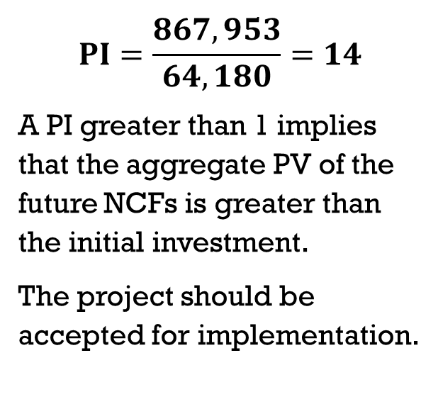
Illustration 10.3: Based on PI
$$PI=\frac{867,953}{64,180}=14$$
A PI greater than 1 implies that the aggregate PV of the future NCFs is greater than the initial investment.
The project should be accepted for implementation.

Slide 36
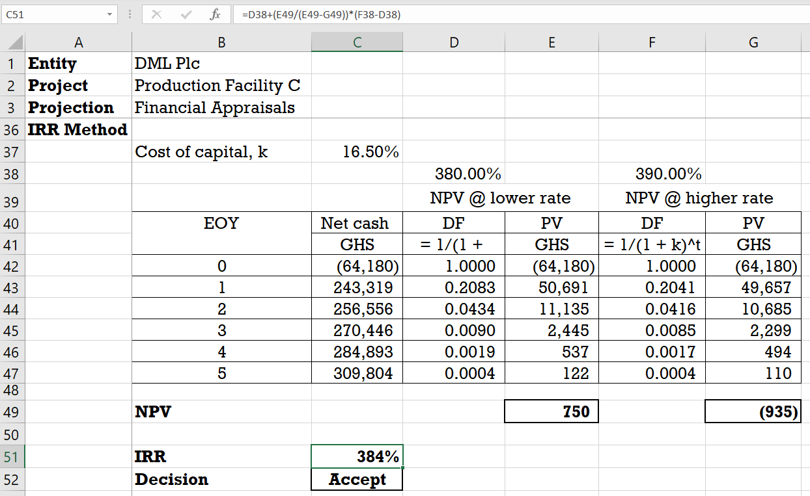
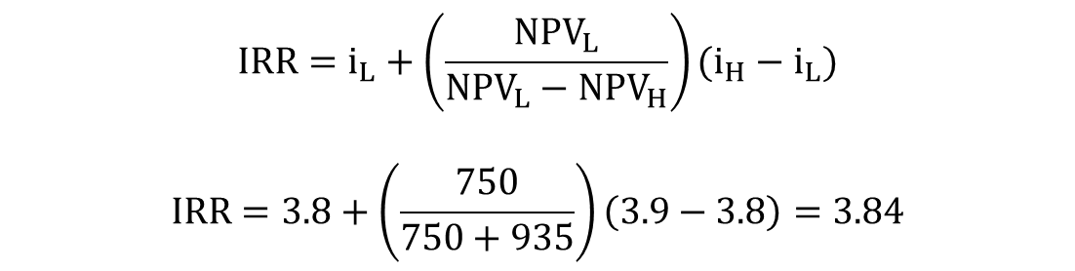
Illustration 10.3: Based on IRR
The IRR of the project is 384%.
As the IRR (384%) is greater than the cost of capital (16.5%), the project should be accepted for implementation.
$${IRR=i}_{L}+\left(\frac{{NPV}_{L}}{{NPV}_{L}−{NPV}_{H}}\right)(i_{H}−i_{L})$$
$$IRR=3.8+\left(\frac{750}{750+935}\right)\left(3.9−3.8\right)=3.84$$

Slide 37
Capital budgeting techniques under uncertainty
Payback period
Sensitivity analysis

Slide 38
Allowing for uncertainty
The payback period
Sensitivity analysis
Businesses typically operate under uncertainty.
It is important to do additional appraisals to assess how the project will perform when conditions change.

Slide 39
Next
The payback period technique

Slide 40
Payback period
Underlying Principle
Cash flows that occur earlier are more certain than those that occur later.
Under uncertainty, a project that would pay back its investment requirement in a shorter period is preferred to those that would pay back later.
The Payback period (PBP) is the period of time required for the cumulative expected cash flows from an investment project to equal the initial cash outflow.

Slide 41
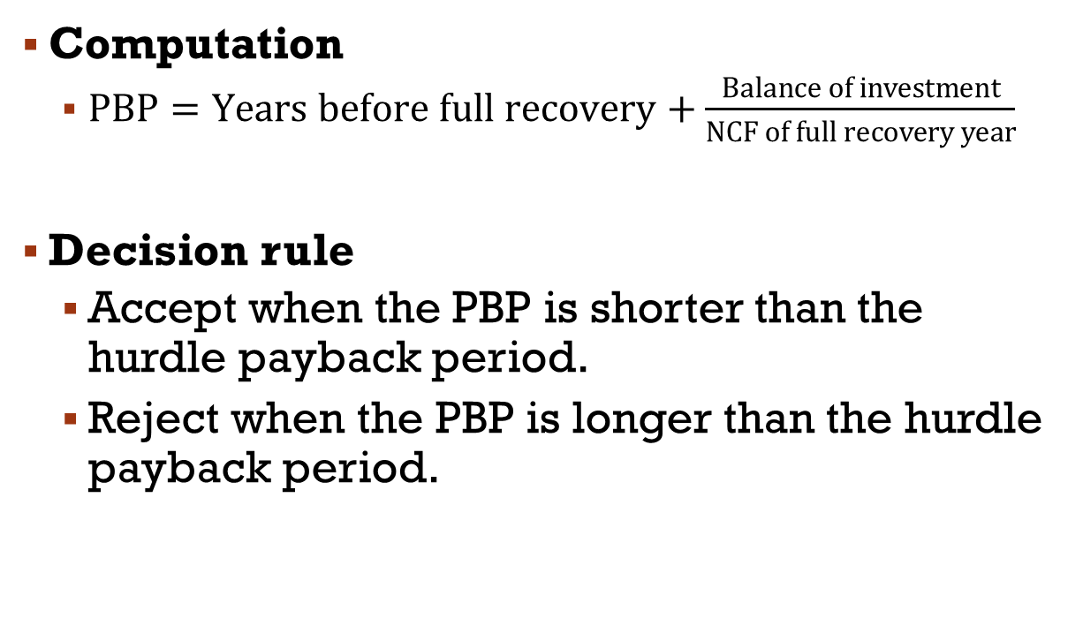
Estimating the traditional payback period
Computation
$PBP=Years before full recovery+\frac{Balance of investment}{NCF of full recovery year}$
Decision rule
Accept when the PBP is shorter than the hurdle payback period.
Reject when the PBP is longer than the hurdle payback period.
Under the traditional PBP, we use the undiscounted NCFs to estimate the payback period.

Slide 42
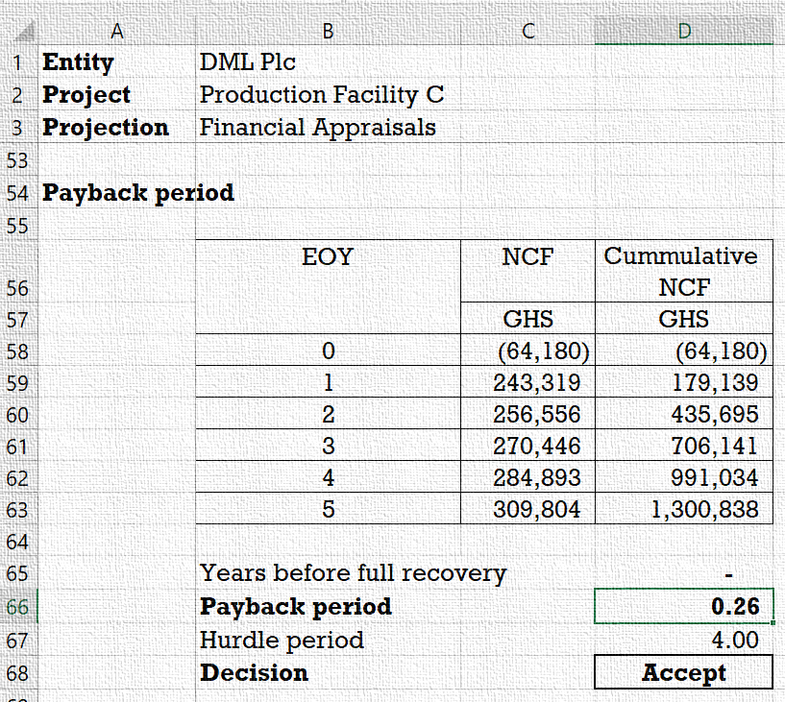
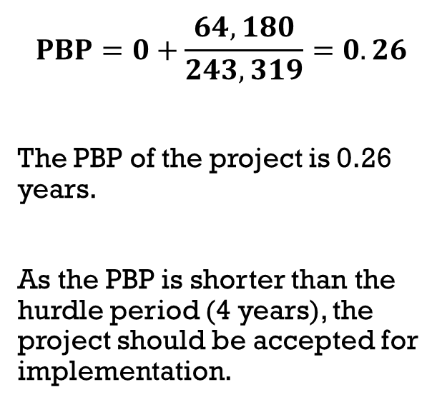
Illustration 10.4: PPB for the DML expansion Project
$$PBP=0+\frac{64,180}{243,319}=0.26$$
The PBP of the project is 0.26 years.
As the PBP is shorter than the hurdle period (4 years), the project should be accepted for implementation.

Slide 43
Strengths and weaknesses of payback period
Strengths
Favours projects that improve liquidity.
Favours projects with lower risk.
Weaknesses
It ignores time value of money.
Late cash flows are ignored.
It favours short-term projects.
Requires a hurdle period, which may be subjective.

Slide 44

Estimating the Discounted payback period
Computation
$PBP=Years before full recovery+\frac{Balance of investment}{PV of full recovery year}$
Decision rule
Accept when the discounted PBP is shorter than the lifespan of the project.
Reject when the PBP is longer than the lifespan of the project.
To address the problem of ignoring the time value of money, a discounted payback period is used in place of the traditional payback period.
The discounted PBP uses discounted cash flows to determine the period within which the initial investment will be recovered.

Slide 45
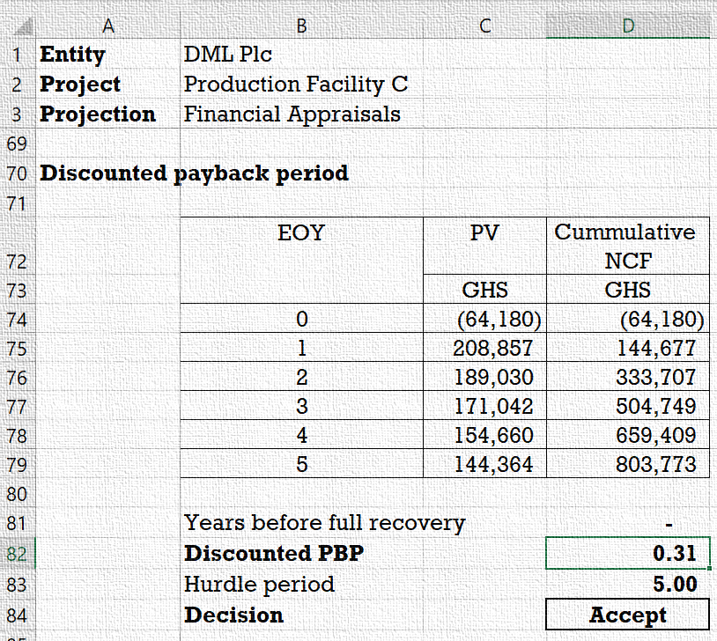
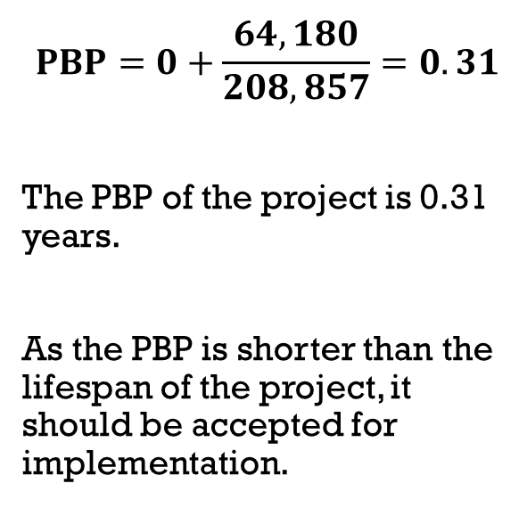
Illustration 10.4: Discounted PPB for the DML expansion Project
$$PBP=0+\frac{64,180}{208,857}=0.31$$
The PBP of the project is 0.31 years.
As the PBP is shorter than the lifespan of the project, it should be accepted for implementation.

Slide 46
Next
Sensitivity analysis

Slide 47
Sensitivity analysis
Graphing the NPV sensitivity profile
Computing the NPV sensitivity percentage
Sensitivity analysis is a study of how changes in the value of a single factor influences the NPV of the project.

Slide 48
The NPV Sensitivity Profile
Graphing the NPV sensitivity profile
Vary a factor while holding other factors constant and compute the resulting NPV.
Plot the varying values of the factor under study and the corresponding NPVs to obtain the NPV sensitivity profile.
You may use the ‘Scatter’ chart type in MS Excel to graph the NPV profile.
The NPV sensitivity profile shows the relationship between changes in a factor estimate and the corresponding changes in NPV.

Slide 49
Sensitivity analysis
Computing the Sensitivity Percentage
Compute the NPV and IRR of the project.
Compute the PV of the factor estimates that are measured in monetary terms.
Sensitivity percentage shows the percentage change in the factor estimate needed to break even (NPV = 0).

Slide 50
Estimating sensitivity to factor estimates
Benefits and costs expressed in money terms:
$$Sensitivity \%=\frac{NPV}{PV of Factor Estimate}×100\%$$
Sensitivity %=NPV/(PV of Factor Estimate)×100%
Discount rate (cost of capital or required rate of return):
$$Sensitivity \%=\frac{IRR−Discount rate}{Discount rate}×100\%$$
Sensitivity %=(IRR−Discount rate)/(Discount rate)×100%

Slide 51
Potential Difficulties
Dependency and mutual exclusion
Ranking problems
Multiple internal rate of return
Capital rationing

Slide 52
Independent vs. Mutually exclusive projects
Independent project
A project whose acceptance (or rejection) does not prevent the acceptance of other projects under consideration.
Mutually exclusive project
A project whose acceptance precludes the acceptance of one or more alternative proposals.
For a single, conventional, independent project, the IRR, NPV, and PI methods would lead us to make the same accept-reject decision.

Slide 53
Ranking problems
Scale of investment
Cash flow pattern
Project life
Ranking mutually exclusive projects for selection using NPV, IRR and PI may produce conflicting results due to certain factors.
Notes:
Scale of investment: Costs of projects differ.
Cash flow pattern: Timing of cash flows differs. For example, the cash flows of one project increase over time whereas those of another decrease.
Project life: Projects have unequal useful lives

Slide 54
Multiple internal rate of return
Main reason for multiple IRR is nonconventional cash flows
A problem with the use of the IRR method is the potential existence of multiple internal rate of return.

Slide 55
Capital rationing
Soft capital rationing
When the limitation on allocation of funds to projects is due to internal restrictions.
Hard capital rationing
When the limitation on allocation of funds to projects is due to external factors.
A situation where a constraint (or budget ceiling) is placed on the total size of capital expenditures during a period.

Slide 56
Selection rule under single-period rationing
Independent but divisible projects
Rank projects based on Profitability Index (PI).
Allocate the fund based on the PI rankings.
Independent but indivisible projects
Create combinations of the projects based on the investment requirement.
Allocate the available fund to the combination that produces the highest NPV.
Mutually exclusive projects
Allocate the available fund to the project with the highest NPV.
Different selection approaches are used depending on the type of projects under consideration.

Slide 57
Illustration 10.6: Single-period capital rationing
Arkbase Ventures has identified five projects with positive NPV but can raise only GHS150,000 in finance for the coming year.
Below are the investment requirements and NPVs of the projects:
Advise the company which project(s) to accept if the projects are:
independent and divisible
independent and indivisible
mutually exclusive
Project | A | B | C | D | E
NPV (GHS’000) | 500 | 400 | 350 | 200 | 280
Investment @ (GHS’000) | 90 | 120 | 60 | 40 | 45

Slide 58
Illustration 10.6: Solution to Part a
With independent and divisible projects, the selection approach is to rank the projects based on their PI.
The funds are allocated based on the PI ranking.

Slide 59
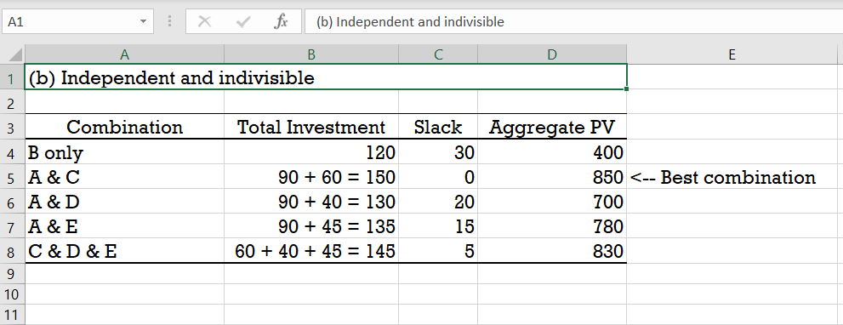
Illustration 10.6: Solution to Parts B
With independent and indivisible projects, the funds are allocated to the combination of projects with the highest aggregate NPV.

Slide 60
Illustration 10.6: Solution to Parts C
Mutually exclusive projects
Project A, which has the highest NPV, should be selected for implementation.
Assuming the projects are mutually exclusive, only one project will be selected for implementation.
Thus, the project with the highest NPV is selected for implementation.

Slide 61
Project Monitoring
Progress review
Post-completion audits

Slide 62
Project monitoring
Progress review
Post-completion audit
When the implementation stage of a project begins it is important to monitor progress continuously to ensure project success.
Vital lessons may be learnt from post-completion audits.

Slide 63

Project management models
Agile
Scrum
Kanban
Lean
Six Sigma
Waterfall
PMI/PMBOK
Notes:
Every project is extremely unique which means we cannot have a standard structure to execute our projects and achieve success in our endeavor.
However, to have a good plan we need a framework or structure to follow depending on the nature of the project.
Projects vary in scope and requirements, which means the right methodology to implement will also vary.

Slide 64
Lecture on Capital Budgeting techniques
The end

